Slide 1

Mental speed is high until age 60 as revealed by analysis of over a million participants
Mischa von Krause, Stefan T. Radev, Andreas Voss
Presenter: Xiao Hu

Slide 2
Introduction
Mental speed: a fundamental property of cognitive agents
Older people are often assumed to be slower thinkers than younger people
across a wide variety of cognitive tasks and contexts
mental speed
age
20 - 30
years
(Hartshorne & Germine, 2015; Salthouse, 2004, 2010; Zimprich & Martin, 2002)

Slide 3
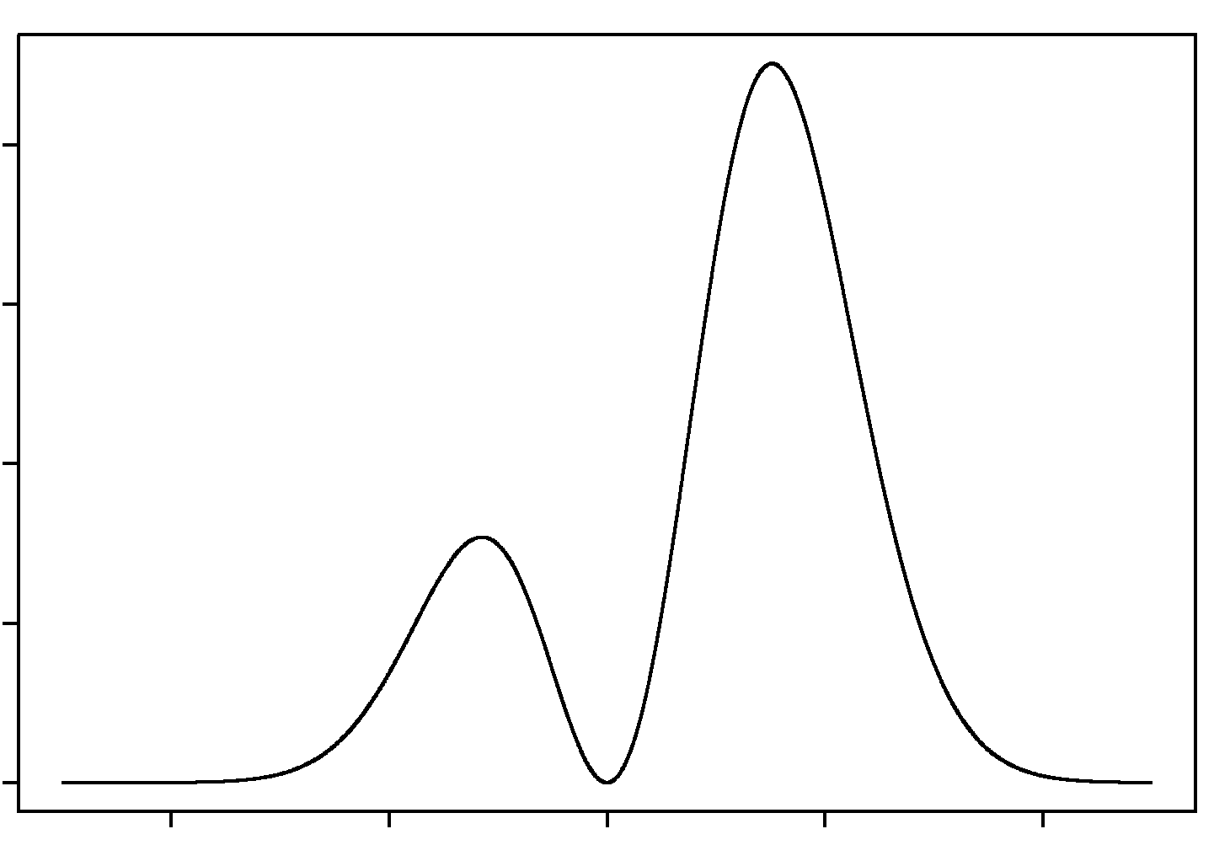
Introduction
Mean response time (RTs): measure of mental speed in previous studies
Two major shortcomings
mean RTs do not utilize the full information in RT distributions, and ignore accuracy data
mean RTs are not pure measures of mental speed, but the sum of disparate cognitive processes (e.g., speed-accuracy tradeoff; encoding and motor processes)
correct
incorrect
RT
0

Slide 4
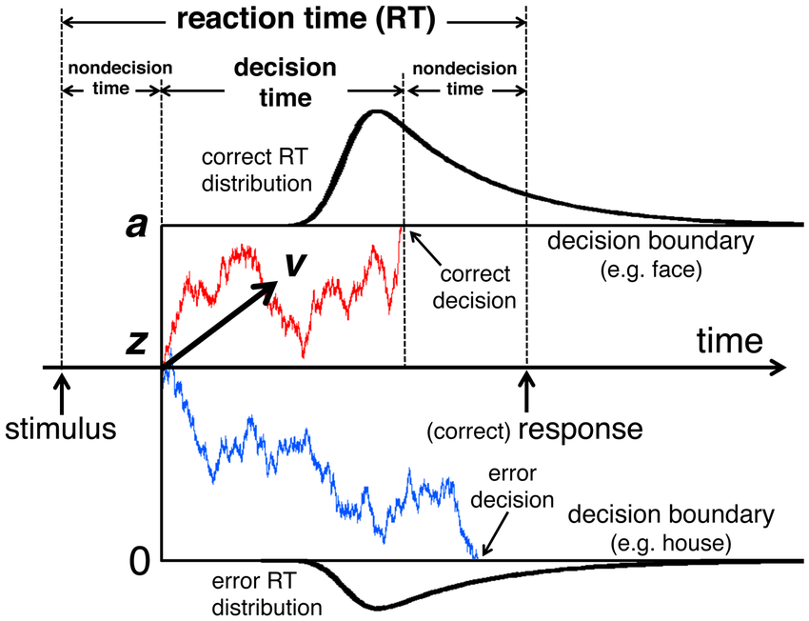
Introduction
Diffusion model (DM): decompose observed behavior into plausible parameters
Drift rate (v): a model-based estimate of mental speed
specifically reflect the speed of evidence accumulation
independent of decision caution (boundary separation) and the time for encoding and motor processes (non-decision time)

Slide 5
Introduction
Previous DM studies on age differences:
most studies compared groups of young adults (~ 20 years) with old adults (60 years or older)
mental speed often exhibits no difference between young and old adults
decision caution and non-decision time markedly increased in old age
(Ball & Aschenbrenner, 2018; Dully et al., 2018; Janczyk et al., 2018; Ratcliff et al., 2010)

Slide 6
Introduction
Many model-based studies have two serious shortcomings
small sample size (problematic for research on individual differences)
compared only two age groups, which limit the generalizability of results (e.g., to age span between 25 and 60 years)

Slide 7
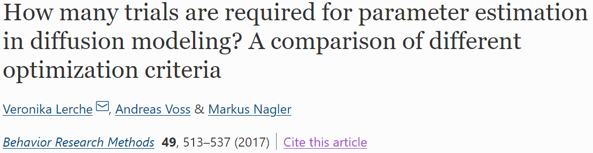
Introduction
Two main reasons for small sample size in DM studies:
First, data collection is tedious given the large number of trials per person that were long thought to be required
such requirements are now considered to be largely overstated (Lerche et al., 2017)

Slide 8
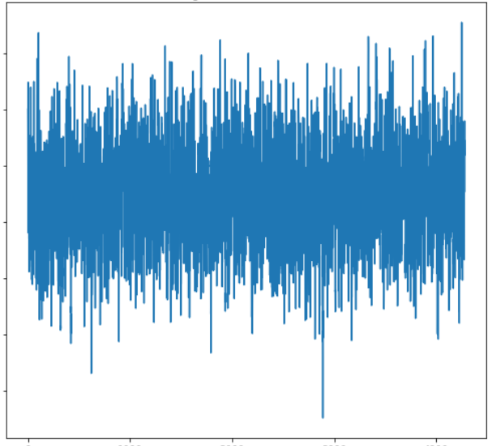
Introduction
Two main reasons for small sample size in DM studies:
Second, fitting DM is computationally expensive (especially for Bayesian methods)
Bayesian methods allow for uncertainty quantification in the form of full posterior distributions
However, standard Bayesian methods (e.g., Markov chain Monte Carlo) is computationally slow

Slide 9
Introduction
The current study
utilize a deep learning framework to scale up model-based Bayesian inference
analyze cross-sectional age differences in DM parameters estimated from more than 1,000,000 participants
cover childhood till late adulthood (ages 10 to 80)

Slide 10
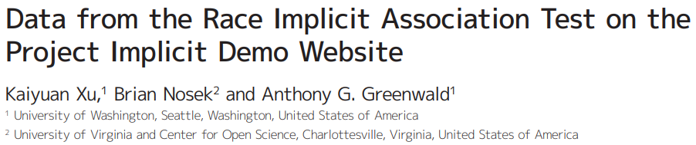

Methods
Dataset
race implicit association test (IAT) data from Project Implicit
Still updating!

Slide 11
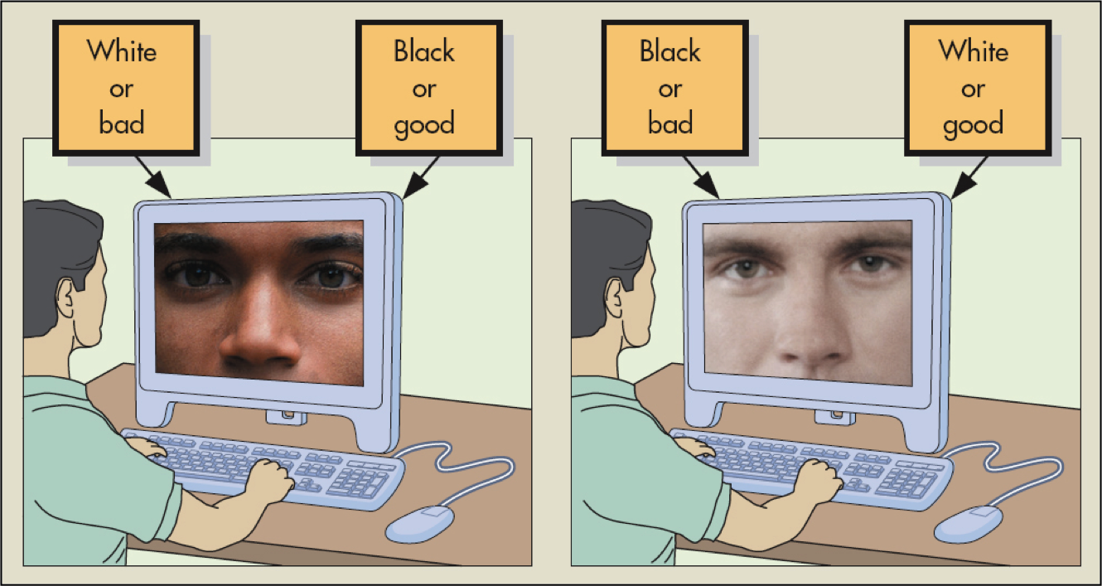
Methods
Race IAT

Slide 12
Methods
Race IAT
designed to measure implicit racial bias
people have to classify words and images as belonging to one of two categories (good/bad or Black/White)
congruent condition: “good” share a common key with “White”
incongruent condition: “good” share a common key with “Black”
60 trials in each condition

Slide 13
Methods
Race IAT
originally, difference in mean RTs between conditions is a measure of implicit racial bias
here we use race IAT only as an example of simple binary decision task

Slide 14
Methods
1,313,275 people provided both their age and RT data
Exclude participants:
containing any latency of zero
with trial number different from the planned 120
with below chance accuracy (< 0.5)
without any error in the two conditions
with more than 12 RTs (10% trials) faster than 300 ms

Slide 15
Methods
1,313,275 people provided both their age and RT data
Exclude participants:
older than 80 years old (due to low sample size in very high age)
with any parameter estimates beyond the bounds of our (very broad) uniform priors
疑问：这是怎么做到的？按理说，如果参数的先验分布是一个uniform distribution，则后验分布无论如何都不会超出先验分布规定的参数取值范围。或者作者是去除了后验分布非常贴近参数取值范围边界的被试？

Slide 16
Methods
1,185,882 people constitute the final sample
robust sample size across the entire age span of 10 to 80 years
38.69% were female
46.89% completed college-level education
84.06% were born in the United States

Slide 17
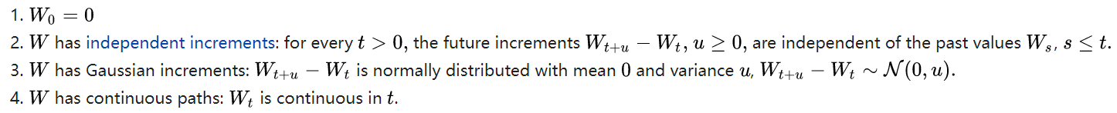
Methods
Diffusion model: standard Wiener process + drift
properties of standard Wiener process:

Slide 18
Methods
Diffusion model: standard Wiener process + drift
standard Wiener process with additional drift:
v is drift rate
decision is made when any boundary is reached (correct vs. incorrect)
additive time τ for non-decision process

Slide 19
Methods
Fit DM to observed data with 6 free parameters
drift rate v separately for two conditions (congruent vs. incongruent)
boundary separation a separately for two conditions
v and a have been shown to differ across the IAT conditions (Klauer et al., 2007)

Slide 20
Methods
Fit DM to observed data with 6 free parameters
non-decision time separately for correct and incorrect responses, τ_{c} and τ_{n} (constant in two conditions)
in IAT, trials do not terminate immediately following a wrong response but require participants to correct their response
time for this additional response was taken into the incorrect non-decision time τ_{n}
relative starting point z was fixed to 0.5

Slide 21
Methods
Fit DM to observed data with 6 free parameters
inter-trial variability parameters were not considered
these parameters are hard to estimate, and trial number for IAT is rather low
(Lerche et al., 2017)

Slide 22
Methods
Priors for parameters:
broad uniform prior

Slide 23
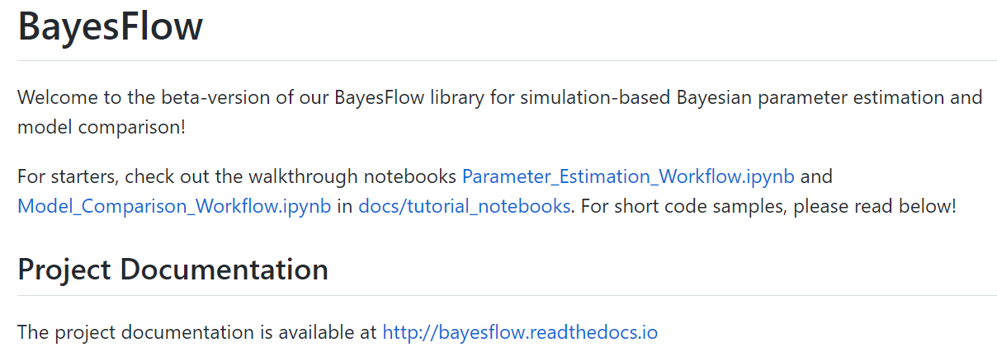
Methods
Bayesian parameter estimation via specialized neural networks BayesFlow
(Radev et al., 2020)
https://github.com/stefanradev93/BayesFlow

Slide 24
Methods
Bayesian parameter estimation via specialized neural networks BayesFlow
Two networks
summary network h: reduce datasets (RTs) of arbitrary size to fixed-size vector representations (which were then used by the inference network)
inference network f: generate samples from an approximate posterior via an invertible neural network (INN)

Slide 25
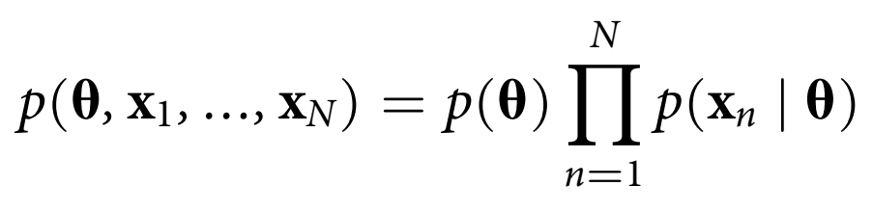
Methods
The networks were trained via simulations from the full Bayesian model
sample parameters from priors, and then generate synthetic datasets
50,000 simulations

Slide 26
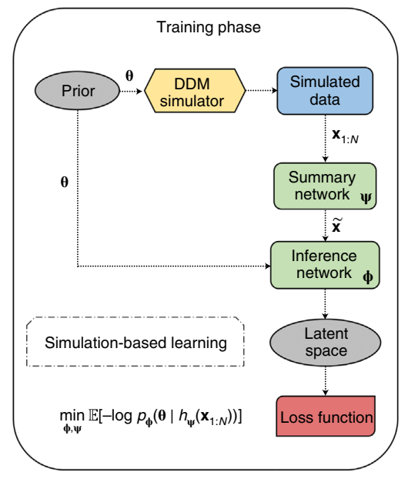
Methods
Simulated data were fed to the neural networks
The networks’ parameters are optimized via standard backpropagation
The networks were trained to minimize the Kullback–Leibler divergence
K-L divergence

Slide 27
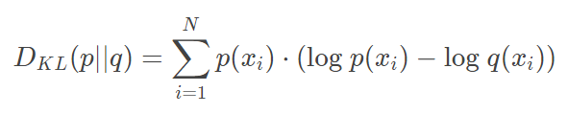
Methods
Kullback–Leibler divergence
divergence (statistical distance) of probability distribution Q from probability distribution P
different from geometric distance because it is asymmetric!
also called relative entropy!

Slide 28
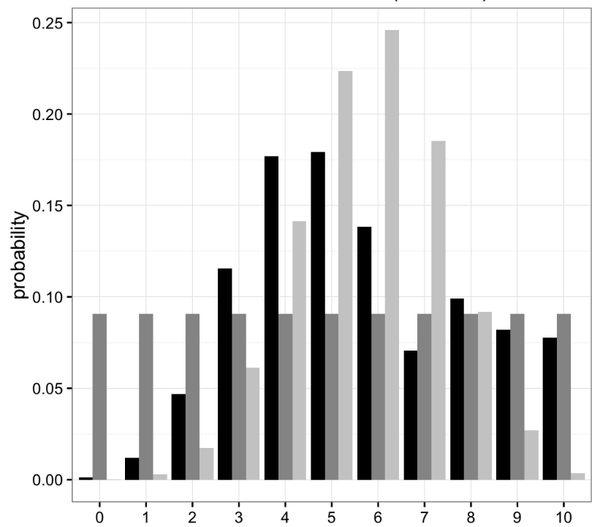

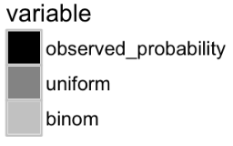

Methods
Observed data is better characterized by uniform (rather than binomial) distribution
The well-known Akaike information criterion (AIC) is based on K-L divergence!
Introduction of K-L divergence: https://www.countbayesie.com/blog/2017/5/9/kullback-leibler-divergence-explained

Slide 29
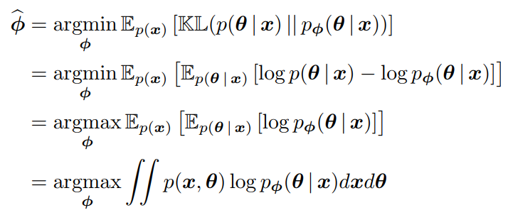
Methods
K-L divergence in Bayesflow:
true posterior distribution
posterior distribution from inference network
The parameters ϕ for inference network are optimized based on:
average K-L divergence across simulated datasets x
(weighted by probability density of x)
(Radev et al., 2020)

Slide 30
Methods
K-L divergence in Bayesflow:
true posterior distribution
posterior distribution from inference network
expectation based on distribution p
The parameters ϕ for inference network are optimized based on:
expectation based on the true posterior distribution p(θ | x)
(Radev et al., 2020)

Slide 31
Methods
K-L divergence in Bayesflow:
true posterior distribution
posterior distribution from inference network
The parameters ϕ for inference network are optimized based on:
dropped because it is unrelated to network parameters
(Radev et al., 2020)

Slide 32
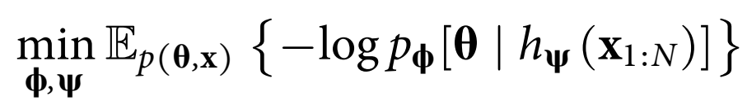
Methods
Equation given in the current paper:
data transformed by the summary network h with parameters Ψ
expectation based on distribution p(x, θ)

Slide 33
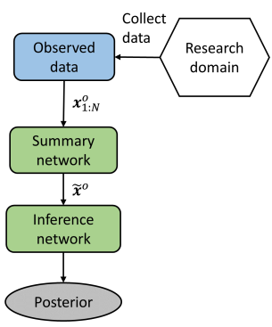
Methods
Model fitting to empirical data after training
Inference on the entire dataset ( > 1 million people) took approximately 24 hours on a machine without GPU acceleration!

Slide 34
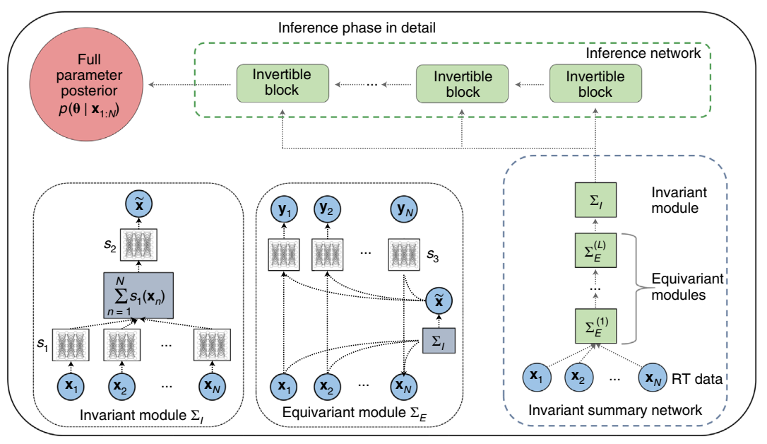
Methods
Model fitting to empirical data after training

Slide 35
Methods
After getting parameter estimates for each participant:
Fitting curves for the nonlinear relationships between age and the parameters (and also mean correct RT)
First step:
linear Bayesian change-point regression on the age-group-averaged data using the R package mcp
ignores variability within an age group and focuses on change-point detection

Slide 36
Methods
Priors over change points which reflect the trends visible in the data:
mean correct RT:
drift rate:
boundary separation:
non-decision time:
Use posterior means for change points to divide age span into segments

Slide 37
Methods
Second step:
Bayesian ridge regression separately for each segment with participant-level data
default priors through the scikit-learn implementation in Python
疑问：根据我的了解，ridge regression可以在一定程度上克服多个自变量的共线性问题，但它给出的回归系数估计值不是无偏的。通常用于自变量较多的回归分析中。这里只有一个自变量age，为何要使用ridge regression？

Slide 38
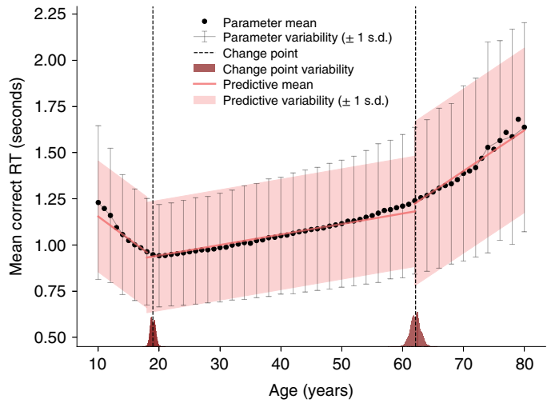
Results
Mean correct RT (incongruent condition):
decrease from 10 to 20 years (change point: 19), b = −0.024, 95% HDI (−0.025, −0.023)
increase after that (change point: 62), b = 0.006, 95% HDI (0.006, 0.006)
the increase in RT then accelerates, b = 0.022, 95% HDI (0.021, 0.023)

Slide 39
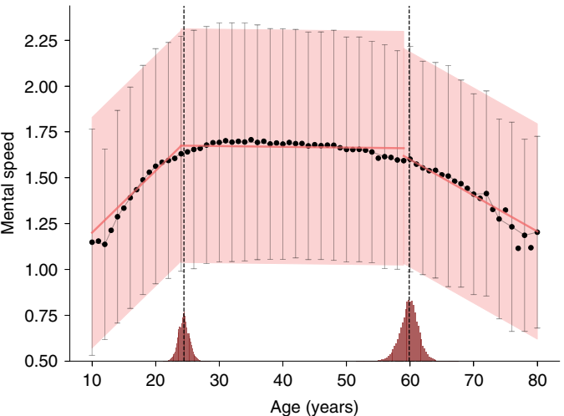
Results
Drift rate (incongruent condition):
increase from 10 to 30 (change point: 24), b = 0.034, 95% HDI (0.033, 0.034)
remain stable until 60 (change point: 60), b < 0.001, 95% HDI (-0.001, 0.000)
then decrease, b = -0.020, 95% HDI (-0.021, -0.018)

Slide 40
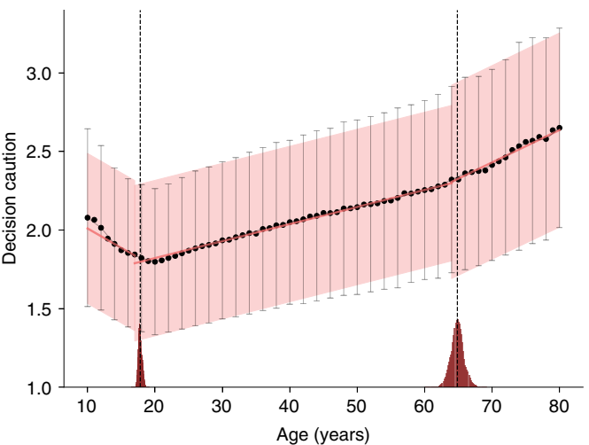
Results
Boundary separation (incongruent condition):
decrease from 10 to 20 (change point: 18), b = −0.025, 95% HDI (−0.026, −0.023)
increase after that (change point: 65), b = 0.011, 95% HDI (0.011, 0.011)
the increase then accelerates, b = 0.021, 95% HDI (0.018, 0.023)

Slide 41
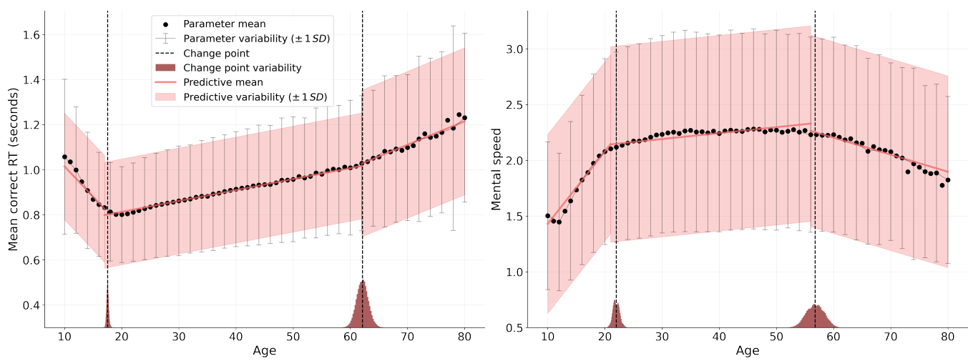
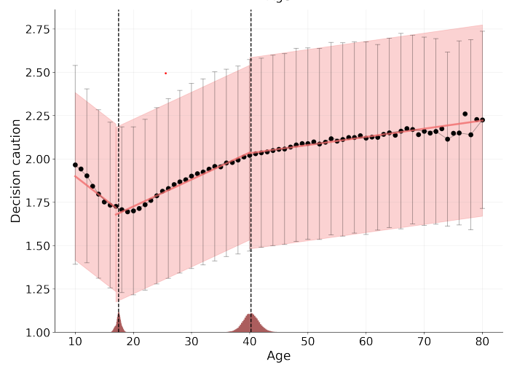
Results
Similar results for congruent condition

Slide 42
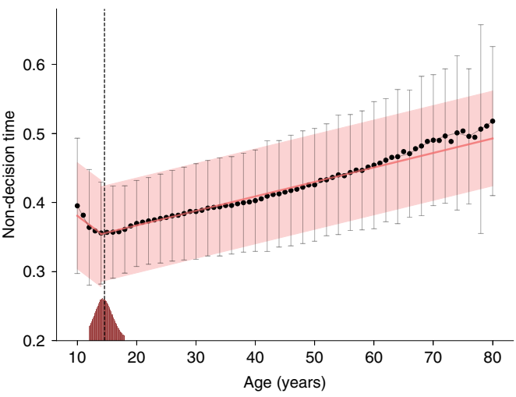
Results
Non-decision time (correct response):
decrease from 10 to 15 (change point: 15), b = −0.006, 95% HDI (−0.008, −0.005)
increase after that, b = 0.002, 95% HDI (0.002, 0.002)

Slide 43
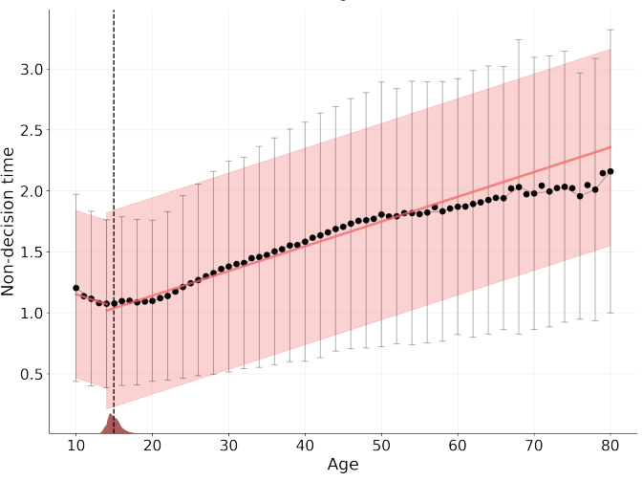
Results
Similar results for non-decision time in incorrect trials

Slide 44
Results
Variability in the mean correct RTs increases across the lifespan
correlation between age and SD in mean correct RT: r=0.78; 95% HDI (0.70, 0.85)

Slide 45
Results
Age-related variability increase is also found for:
correct non-decision time, r=0.75; 95% HDI (0.67, 0.83)
error non-decision time, r=0.92; 95% HDI (0.90, 0.95)
incongruent boundary separation, r=0.48; 95% HDI (0.33, 0.63)
congruent boundary separation, r=0.90; 95% HDI (0.87, 0.94)
No clear patter of age-related variability increase for drift rate
incongruent, r=0.17; 95% HDI (0.00, 0.34)
congruent, r=-0.56; 95% HDI (-0.67, 0.42)

Slide 46
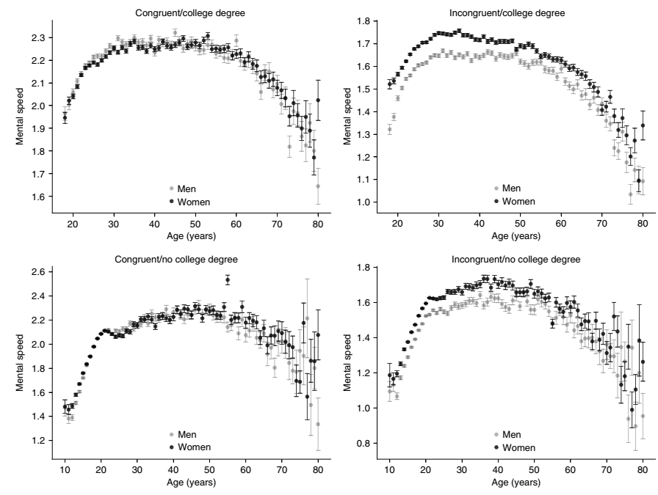
Results
Mean-level pattern for drift rate is robust across:
gender
levels of education
experimental condition

Slide 47
Discussion
Our results replicate the age-related decline in mean RTs previously reported
Boundary separation declines from 10 to approximately 18, and then increase
people at college age were the least cautious
Non-decision time were fastest around age 14 to 16

Slide 48
Discussion
Remarkable finding about drift rate
still increase between 20 and 30 (in contrast to results about mean RT)
remain roughly stable across all of middle adulthood
Age-related increase of RTs in early and middle adulthood can be attributed exclusively to decision caution and non-decision time, not to mental speed
mental speed decline starts much later than has typically been assumed

Slide 49
Discussion
Greater spread (variability) in mean RTs for older people
attributable to greater inter-individual differences in non-decision processes or decision caution, not in mental speed

Slide 50
Discussion
Scaffolding theory of aging and cognition
people may use compensatory techniques (e.g., activation of additional neural networks) to counter the detrimental effects of age-related changes in brain structure
well suited to keeping high level mental speed
more basal processes (captured by non-decision time) might be less adaptable
(Reuter-Lorenz & Park, 2014)

Slide 51
Discussion
Our study presents an example of using DM to analyze IAT data
notable difference in drift rate between conditions
drift rate may reflect association strength in IAT
incongruent
congruent

Slide 52
Discussion
Limitation of the current study
only one particular decision-making task (race IAT)
cross-sectional nature of our findings
the trial numbers for each person were quite low

